Slide 1
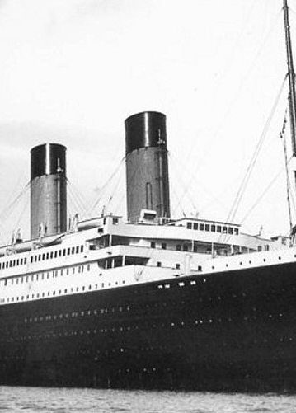
TITANIC SURVIVOR PREDICTION
Presented By:
Virendra Verma

Slide 2
INTRODUCTION
The RMS Titanic was a British passenger liner that struck an iceberg on her maiden voyage and sank, taking the lives of more than 1500 passengers. We are interested in predicting the survival probability for a given passenger. There are many factors which played into which passengers made it into lifeboats and which passengers did not, most notably gender and class assignment. Our purpose is to find a conclusion using different predicting models by the data given a sample of 342 survivors and find if this hypothesis is true or not.

Slide 3
REQUIRED
TOOL USED :
Jupyter Notebook
LIBRARY USED :
Analyzing: Numpy, Pandas, Sci-kit Learn
Visualization: Matplotlib, Seaborn
Prediction models: Decesion Tree, Random Forest Classifier, GaussianNB,
Kneighbors Classifier, Logistic Regression, SVM

Slide 4
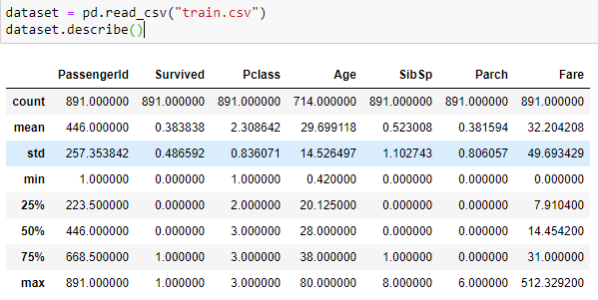
DATA VISUALIZATION
Analyzing Data
From this data, we get that there are 891 total rows with there mean, min, and max values to visualize the data.

Slide 5
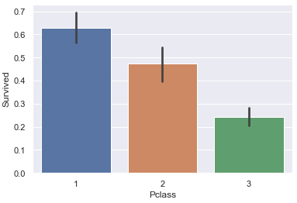
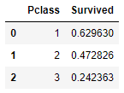
DATA VISUALIZATION
Comparing Pclass with Survived

Slide 6
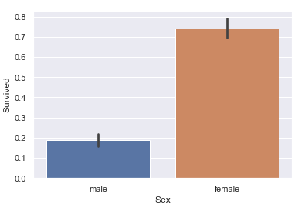

DATA VISUALIZATION
Comparing Sex with Survived

Slide 7
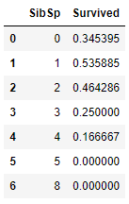
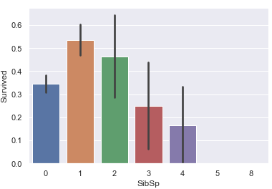
DATA VISUALIZATION
Comparing SibSp with Survived

Slide 8
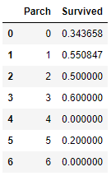
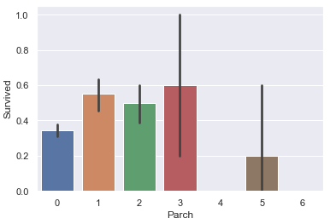
DATA VISUALIZATION
Comparing Parch with Survived

Slide 9
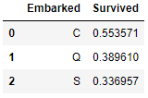
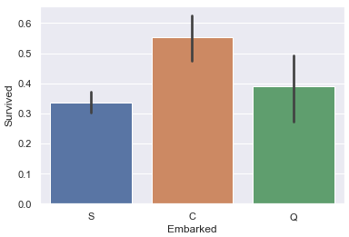
DATA VISUALIZATION
Comparing Embarked with Survived

Slide 10


DATA VISUALIZATION
Checking Max, Min, Mean, Mode
For Fare:
For Age:

Slide 11
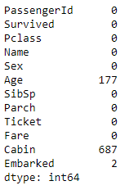
DATA VISUALIZATION
Checking for null values
From this data we get that there are 177 null values in age column and 2 null in embarked column. The data of the cabin is not useful thus, we will exclude that.

Slide 12

DATA VISUALIZATION
The Survived column is dependent upon the Age and Embarked column. They contain some null values, to remove the null value we are filling mean in Age column and S in Embarked column because the occurrence of S is more in the Embarked column. We are filling this to utilize the whole data given in the dataset.

Slide 13
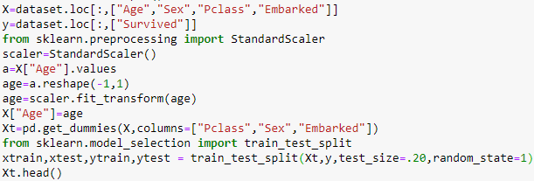
SPLITING DATA FOR TESTING AND TRAINING
From the data visualization, there are four main columns where the output depends upon. Age, Sex, P-class, Embarked. These features are stored in the X list and survived is stored in y.

Slide 14
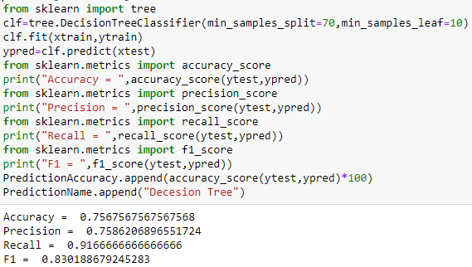
Training Data using Decision Tree

Slide 15
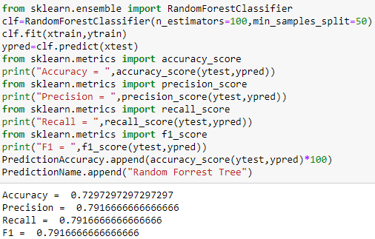
Training Data using Random Forest Classifier

Slide 16
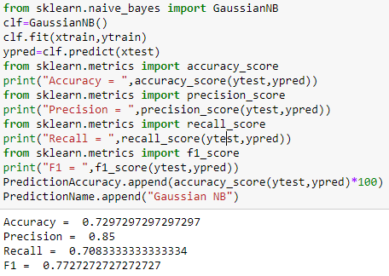
Training Data using GaussianNB

Slide 17
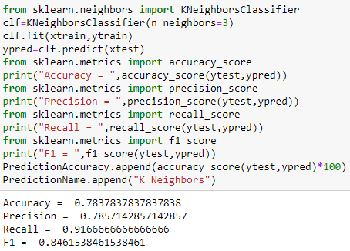
Training Data using KNeighborsClassifier

Slide 18
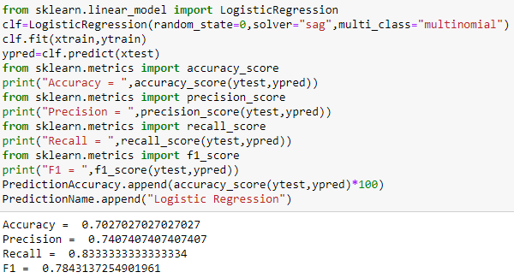
Training Data using LogisticRegression

Slide 19
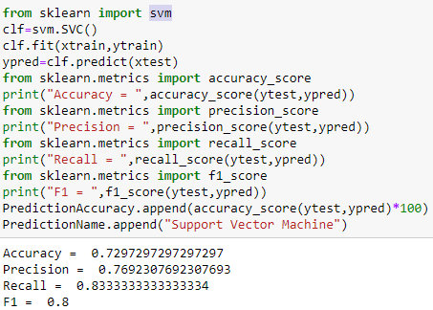
Training Data using Support Vector Machines

Slide 20
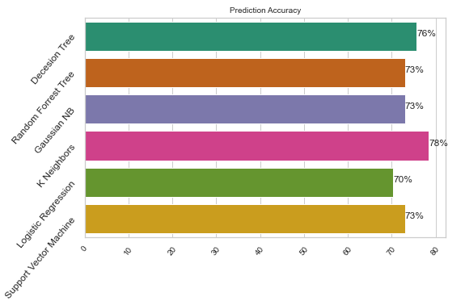
COMPARING MODELS
Comparing all the models with there accuracy

Slide 21
COMPARING MODELS
While comparing some predicting models we can say that Knieghbors is the best model for this dataset which provides 78% of accuracy which is more than other models.
No algorithm can predict with 100% accuracy.
Comparing all the columns we get that the Women, children, first-class passengers as well as people with the small family had a better chance at survival.

